Slide 1



Personalized Learning Pathways to Students using Data Analytics By Shashank Varma Yalala Yasaswini Sonnapareddy
Course :Applied Data Analytics
Instructor: Prof Salem Othman

Slide 2
Main Objective
Aims to create personalized learning pathways for students
Recommends customized study plans based on individual exam score
Identifies weaker subjects for each student
Provides additional resources to strengthen weak areas
Aims at improving student performance through targeted learning strategies

Slide 3
Phase 1- Data Generation and Cleaning
Synthetic dataset using Faker library
Included attributes: Name, Gender , Age, Study Hours (English, Chemistry , Finance ),Interests and Marks
Handles missing values using statistical methods
Cleans the messy data and removes duplicate entries

Slide 4
Phase 2-Data Transformation & Encoding
Applies Normalization and Standardization to numerical fields and.
Encoded categorical fields using Label Encoding for gender and learning preferences
Applies One-Hot Encoding on the Learning Preference feature.
Shows student concentrates on which subject the most.

Slide 5
Phase 3 - Data Visualization
Generates Correlation Matrix
Student performance Analysis and completion rates
Data visualizations among different factors (Engagement vs performance , Avg Marks vs study hours , completion rate vs subject etc.,)

Slide 6

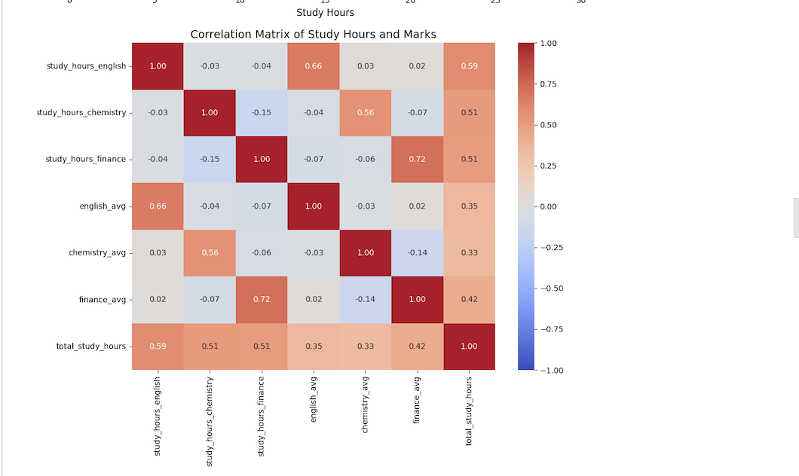

Slide 7
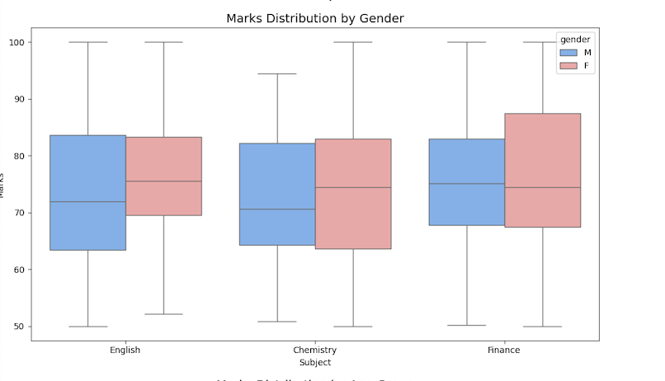

Slide 8

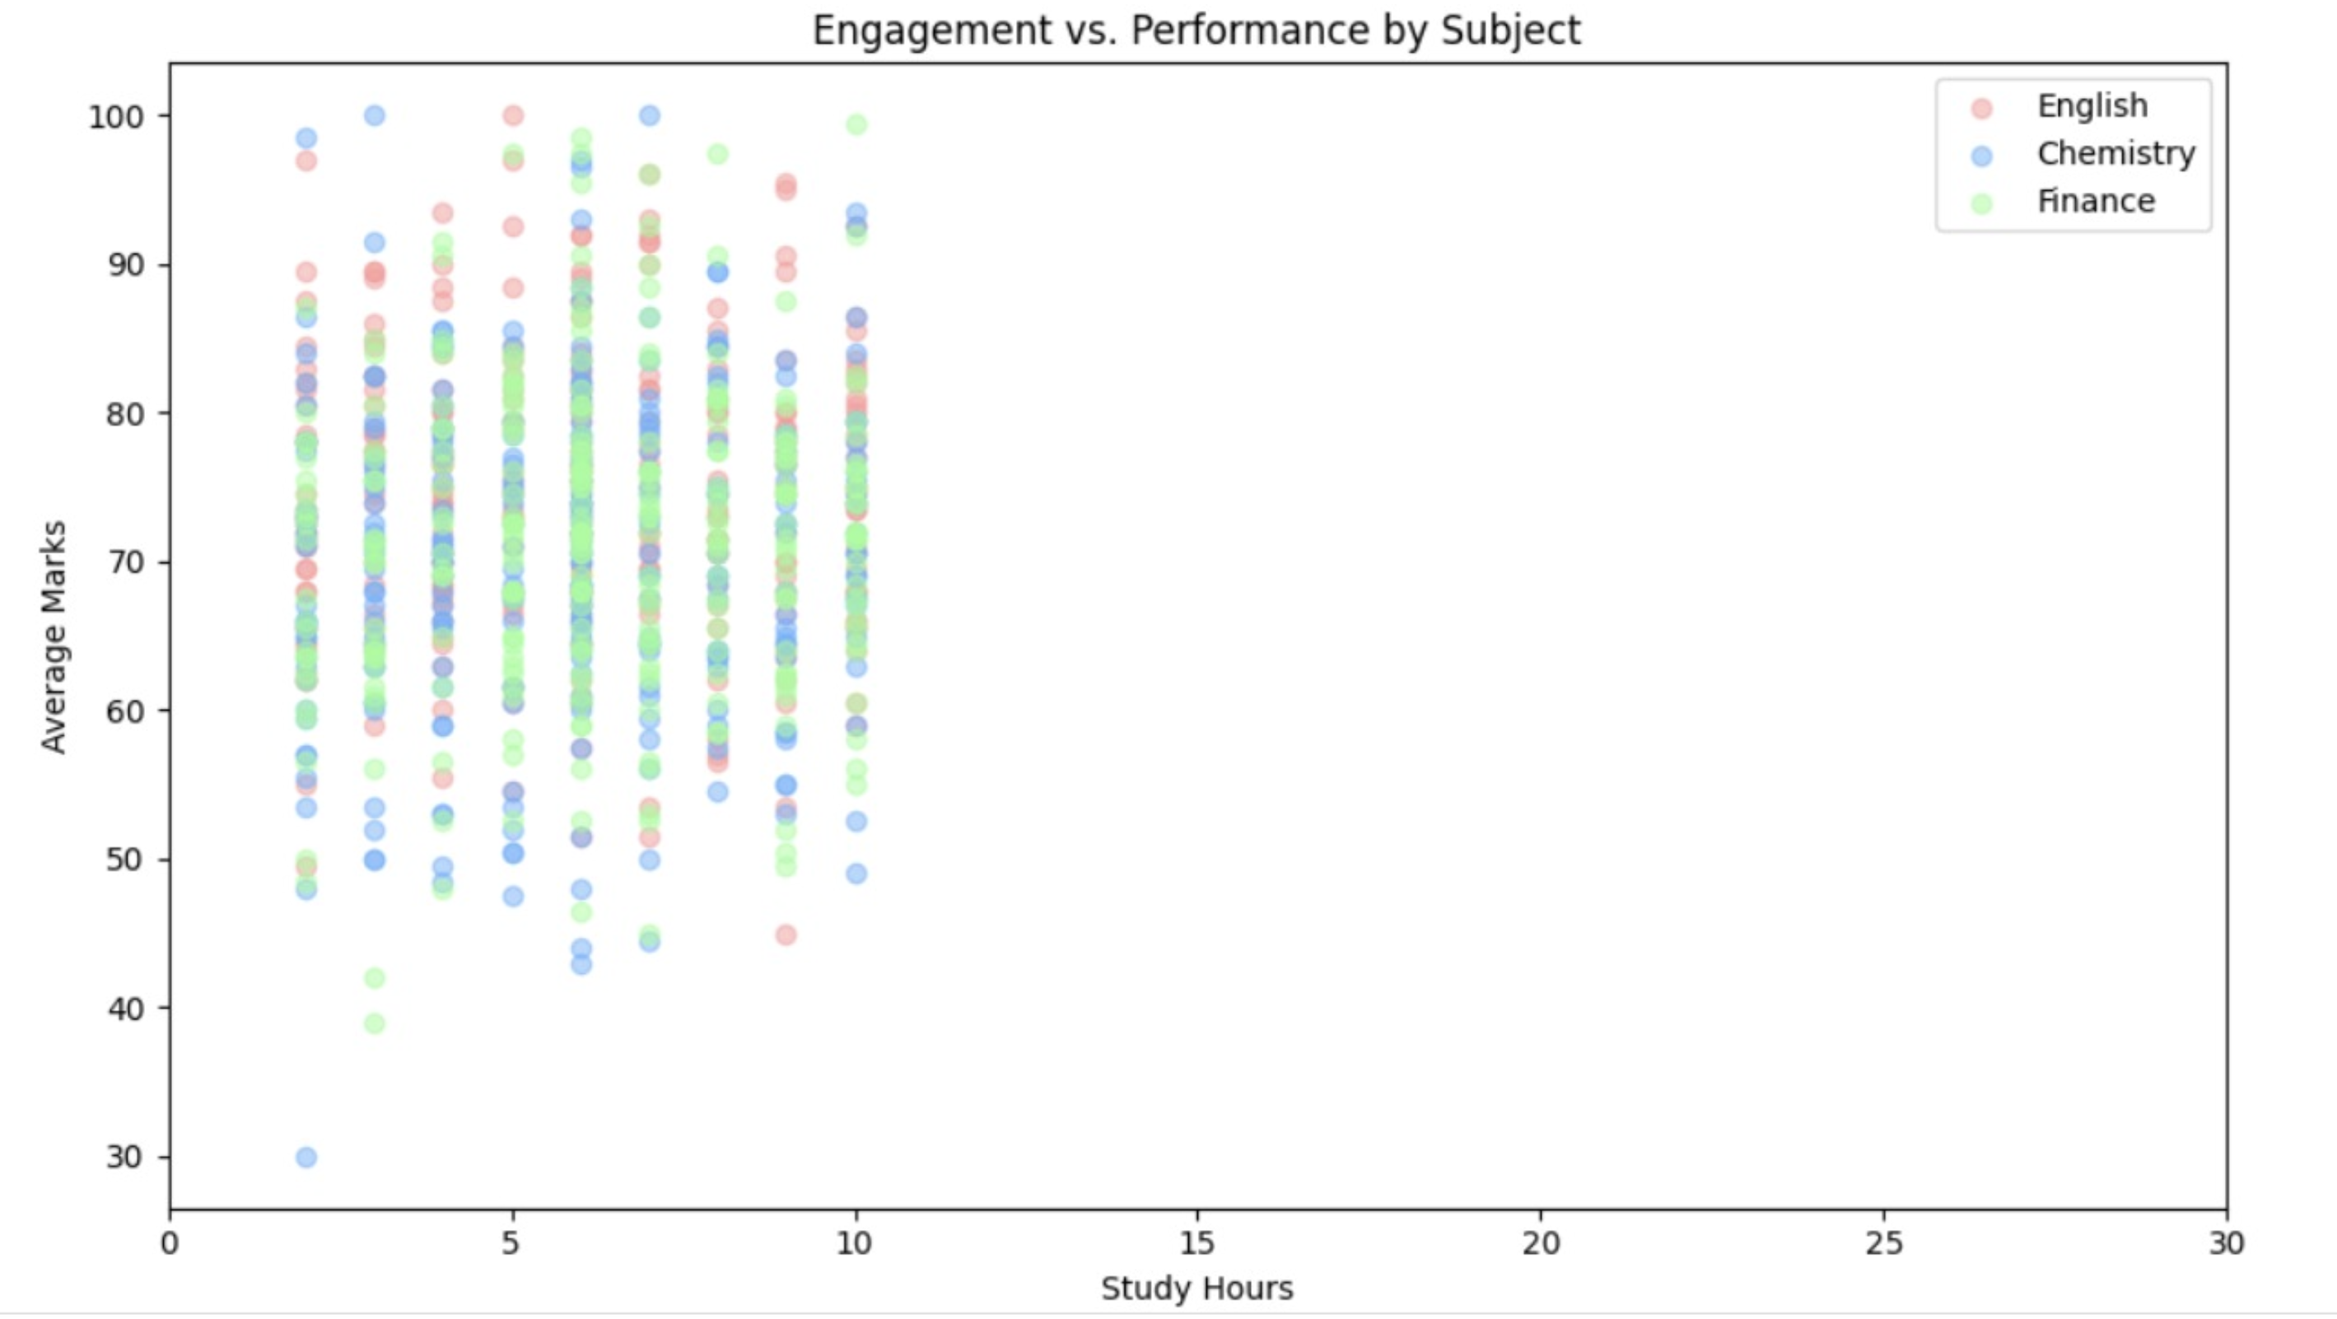
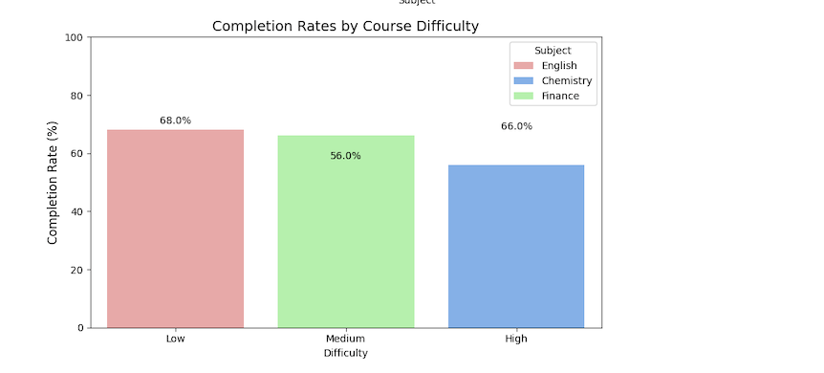

Slide 9
Phase 4-Training the dataset
Build and Train models using Decision Tree Regressor an Random Forest Regressor
Performs Hyperparameter Tuning by applying Grid search CV
Evaluates Model performance by calculating MSE ,MAE and R²

Slide 10
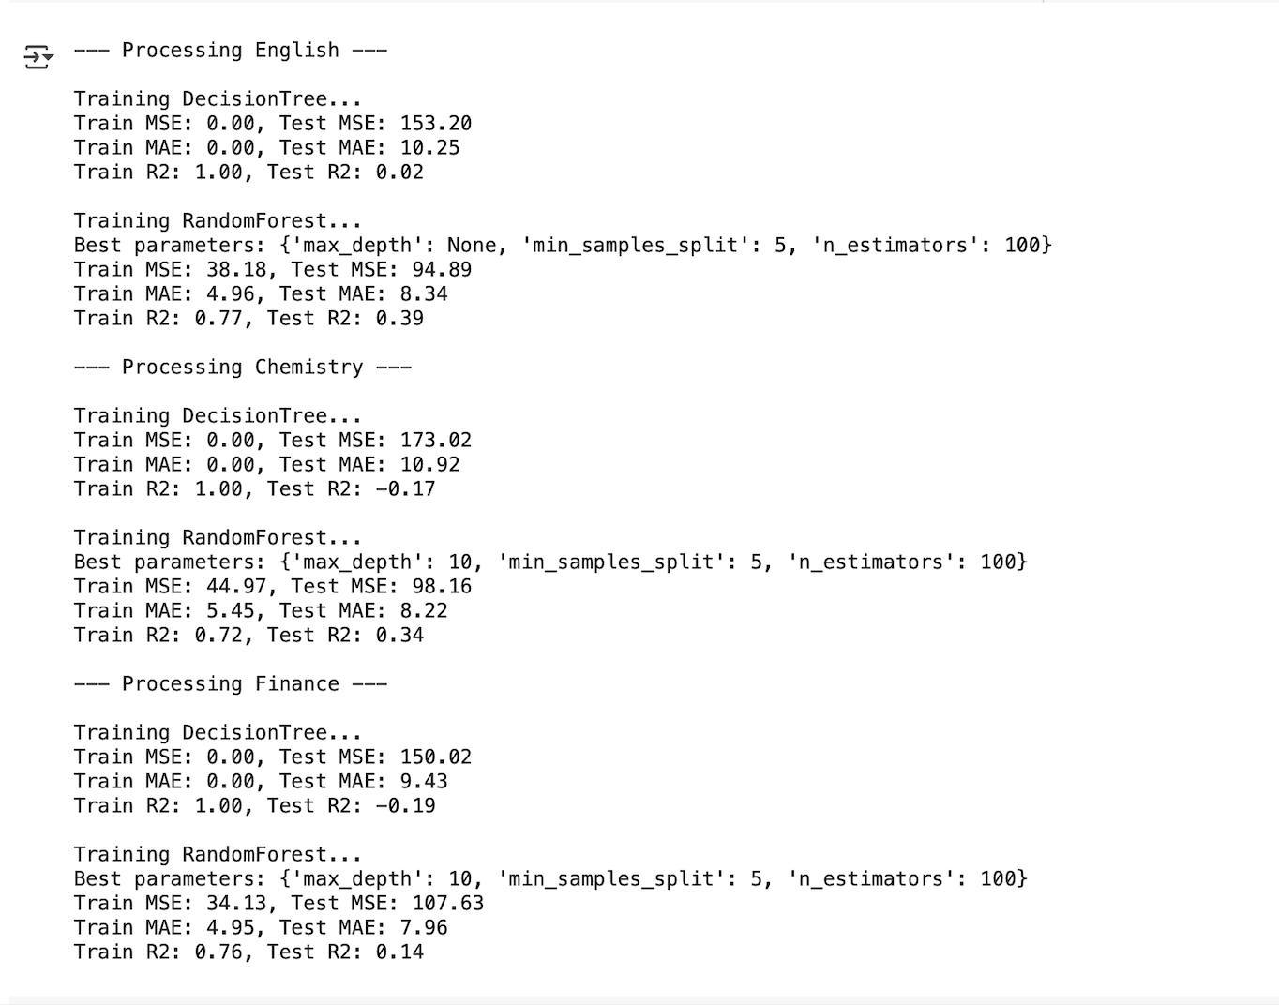

Slide 11
Phase 5-Content Based Filtering and Study Plan Recommendation
Develops a Recommender System comparing marks to a threshold value
Generates personalized study plans with extra study hours and curated learning platforms

Slide 12
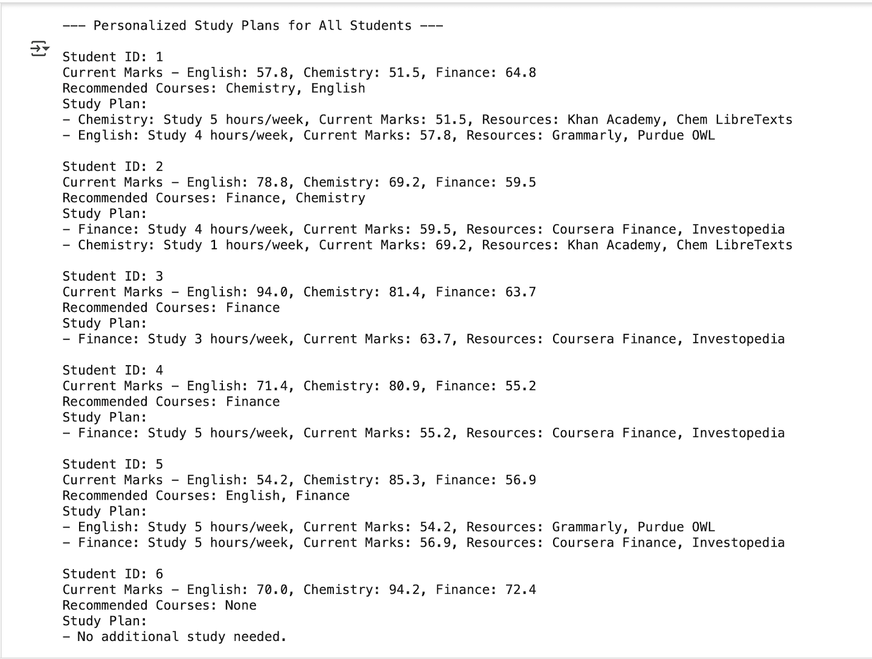

Slide 13
Phase 6-Visualization Dashboard
Creates an interactive dashboard using ipywidgets and matplotlib
Produces visualized study insights with bar charts and text output
Allows to select a student ID and view their performance, study hours and completion status,

Slide 14
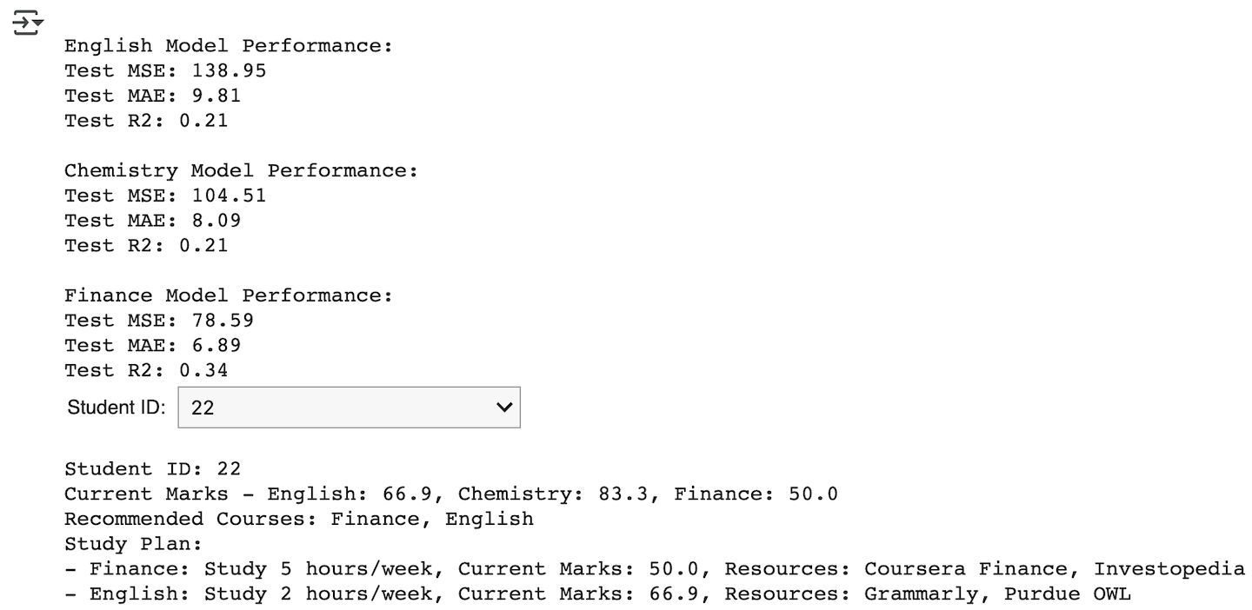
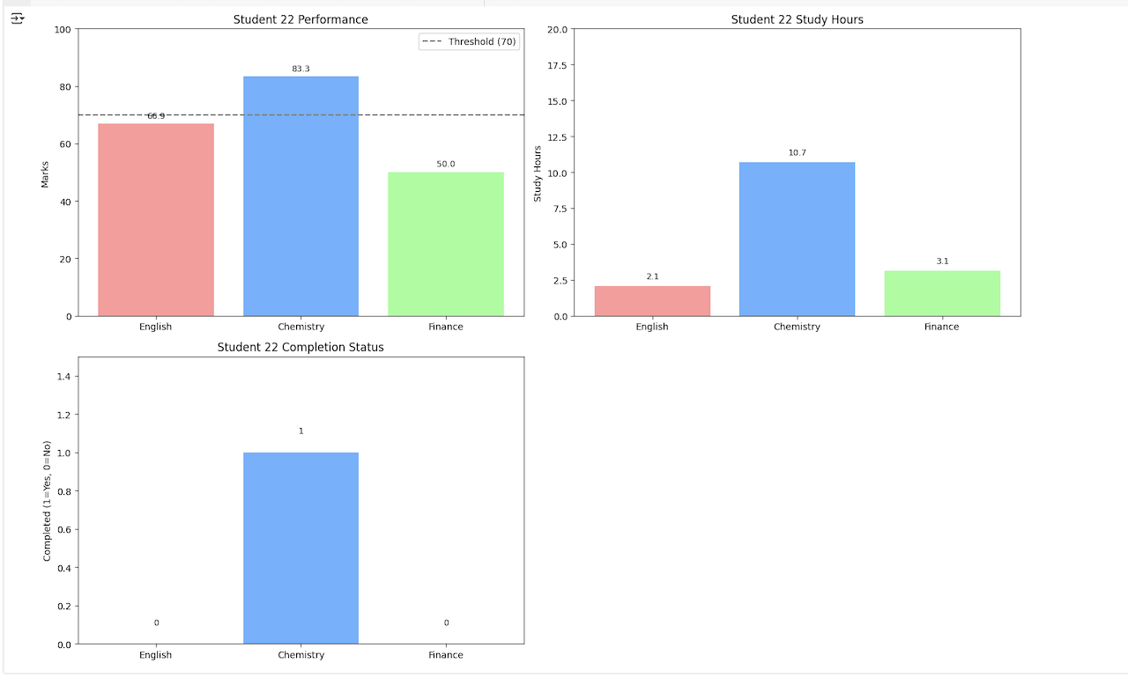
Output

Slide 15
Result
Built a system to create personalized study plans based on students' scores and study time.
Trained Decision Tree and Random Forest models to predict marks from study hours.
Made a Recommender System to suggest extra study hours and useful learning resources.
Designed an Interactive Dashboard to show marks, study plan, and recommendations for each student.
Created a simple and scalable system that can help schools and colleges guide students better.

Slide 16
Conclusion
The project successfully built a personalized learning system that predicts student performance, identifies weak areas, and recommends targeted study plans. By combining machine learning and interactive dashboards, we created a simple and scalable solution to support student growth and academic success.

